Slide 1

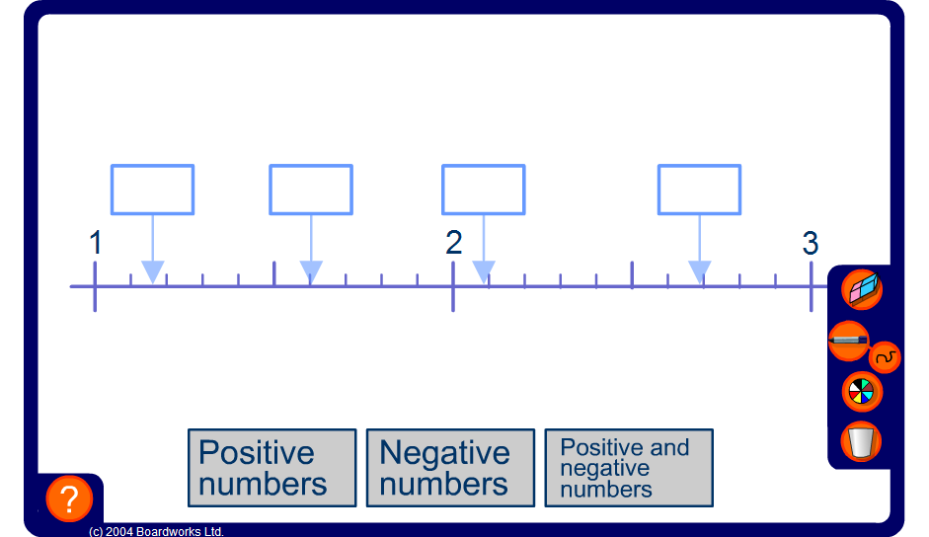


Decimals on a number line
Notes:
The aim of this activity is to help pupils to visualize the positions of decimal numbers on a number line and to estimate the size of decimals between two others by looking at the next decimal place. Click on an empty box to reveal the number inside it.
Differentiate the activity by including positive and negative decimals.

